Slide 1
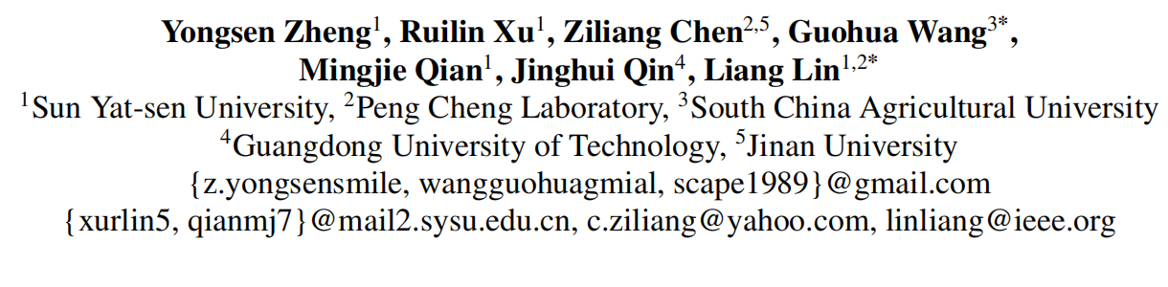





HyCoRec: Hypergraph-Enhanced Multi-Preference Learning for Alleviating Matthew Effect in Conversational Recommendation
（ACL-2024)
Reported by Jiale Shen

Slide 2
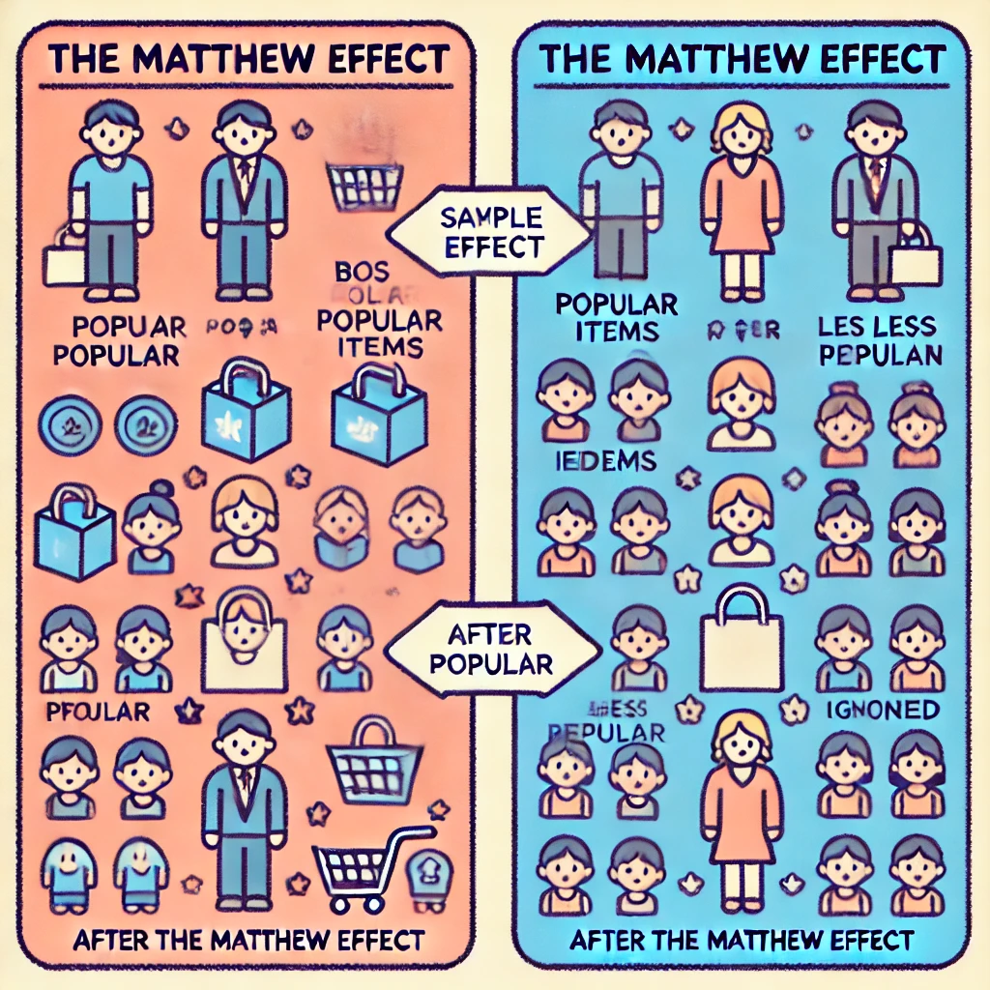
motivation
1.HyCoRec devotes to alleviate the Matthew effect by learning multi-aspect preferences, i.e., item-, entity- , word-, review-, and knowledge-aspect preferences, to effectively generate responses in the conversational task and accurately predict items in the recommendation task when the user chats with the system over time.

Slide 3
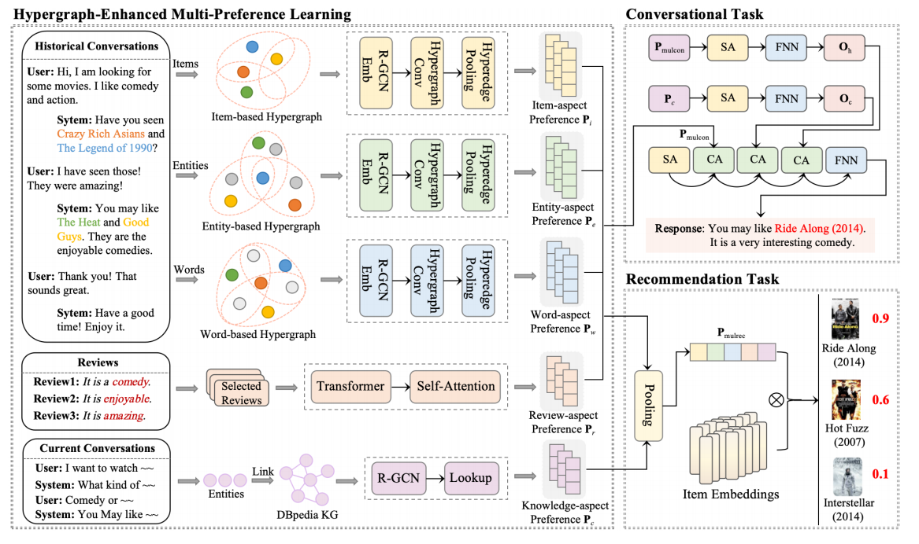
Overview

Slide 4
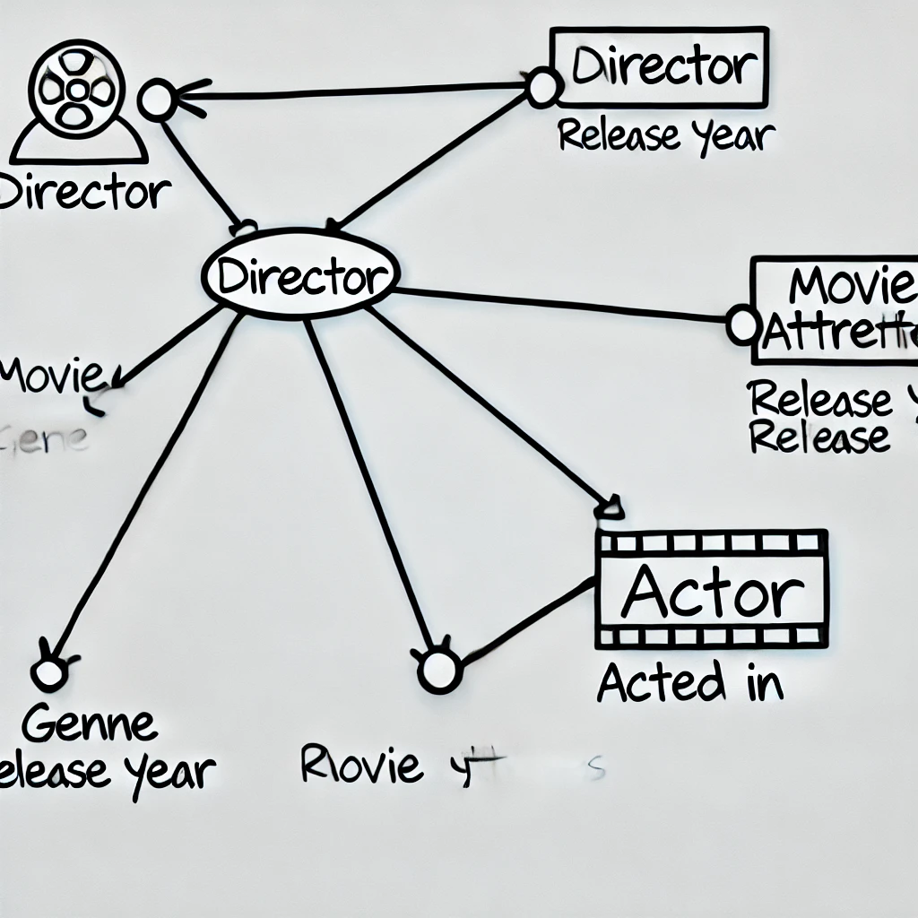
Overview
1. Enrich recommendation semantics
2. Alleviate the problem of cold start
3. Support multi-faceted preference learning
4. Improve the diversity of recommendations
5. Enhanced Dialogue Generation
6. Improve the explanatory nature of recommendations

Slide 5
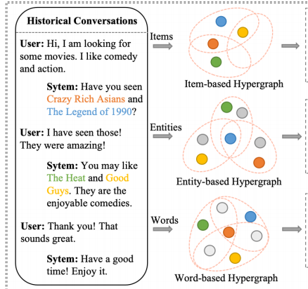

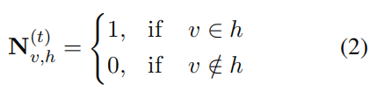


Approach

Slide 6
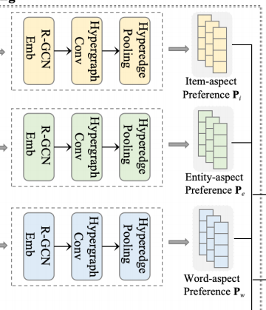
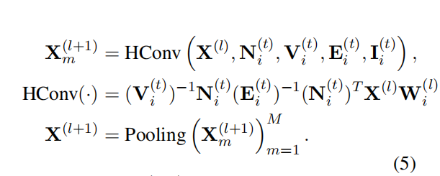
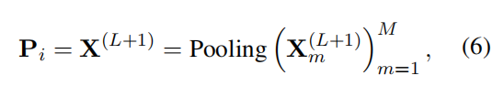
Approach

Slide 7
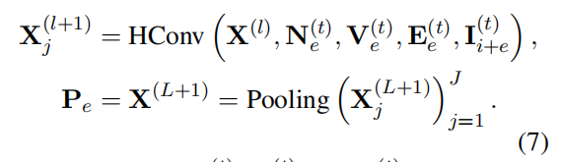
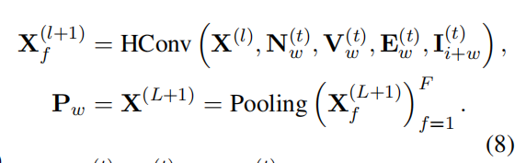
Approach

Slide 8
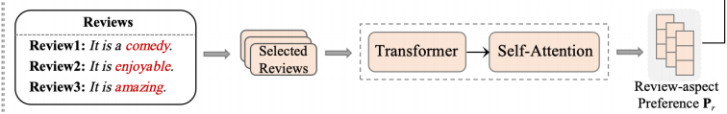
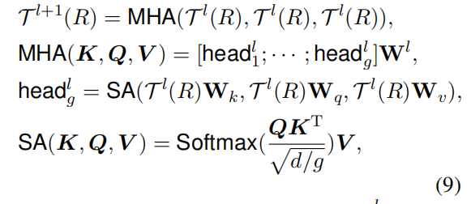

Approach

Slide 9
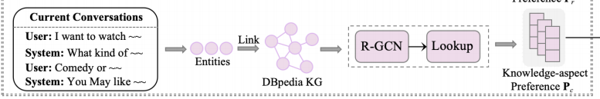


Approach

Slide 10
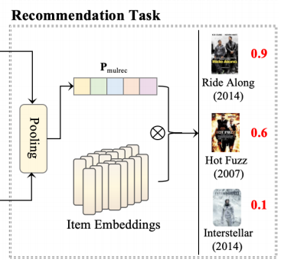


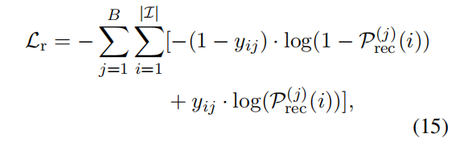
Approach

Slide 11
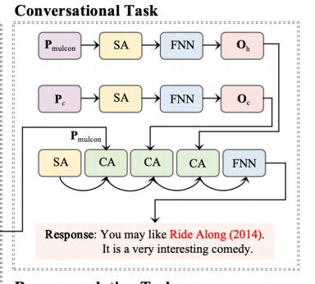
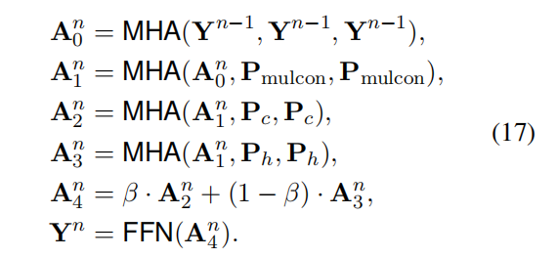
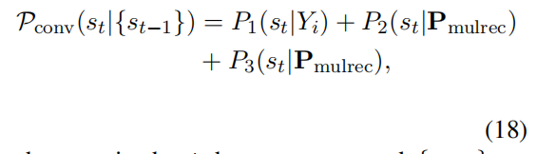
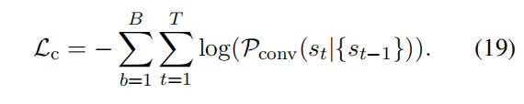
Approach
$$P_{mulcon}=MHA([P_{c};P_{h};P_{r}]) (16)$$

Slide 12
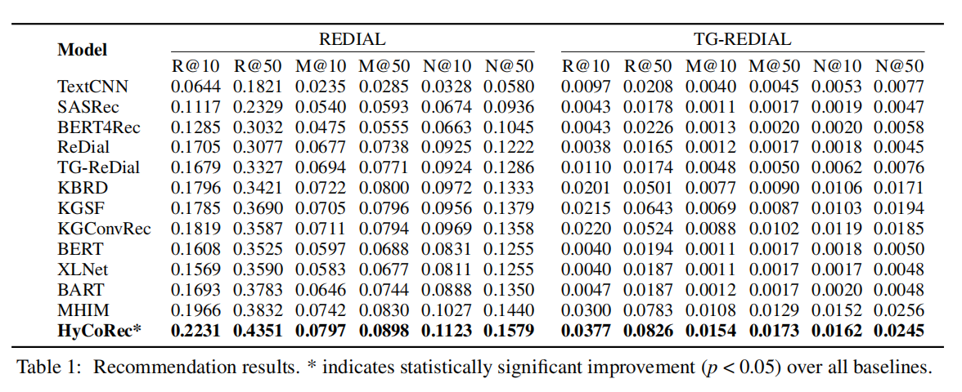
Experiment

Slide 13
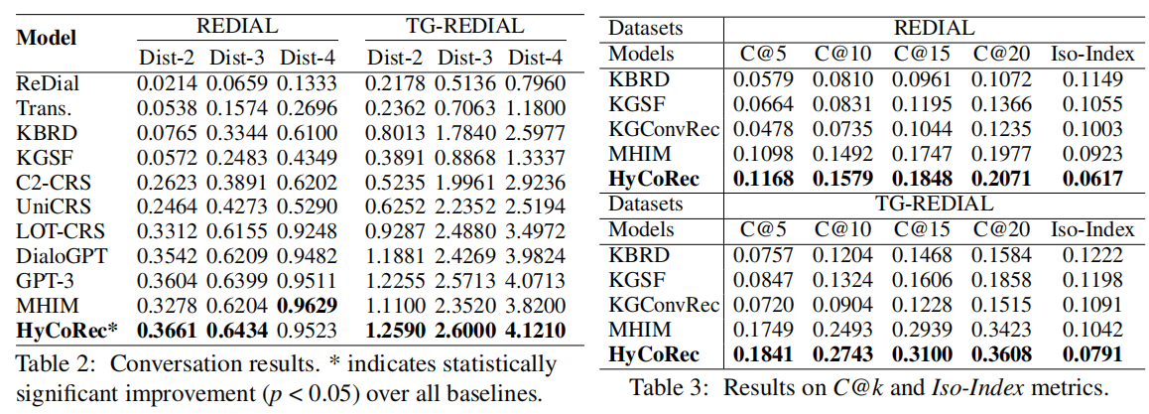
Experiment

Slide 14
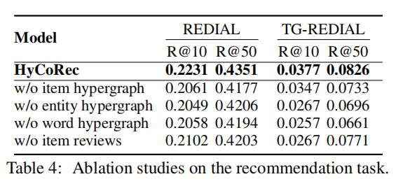
Experiment

Slide 15
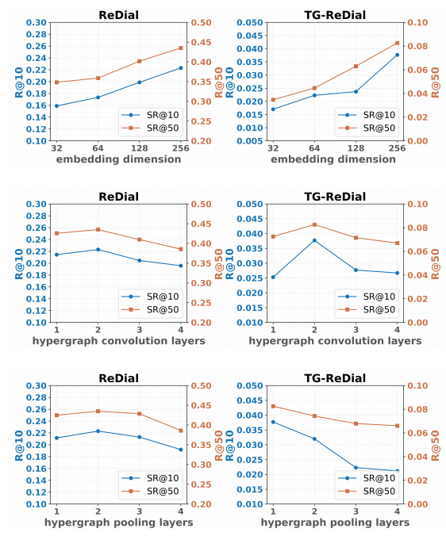
Experiment

Slide 16
Thank you!

